Slide 1
Millennial and alcohol
Jewon, Ahmed, Abdulaziz, Rayan
English School of Canada (UCTP)

Slide 2
Outline
- Introduction
background
- Methodology
survey
interview
- Findings
- Conclusion

Slide 3
Background
Fruit juice and honey have been used to make alcohol in the past.
Alcohol manufacturer started:
In China around 7000 B.C
In Egypt around 3000 B.C

Slide 4
Background
Encouraging the drinking of alcohol.
In eighteenth century in Britain.
The consumption of drinking alcohol.

Slide 5

Background
Temperance Fountain Movement in 20th century.
Temperance means abstinence from alcohol.

Slide 6
Background
Prohibition in America in 20th century.
The American government had to banned alcohol from all the states.
How were the leaders?

Slide 7
Methodology
120 participants were surveyed and interviewed.

Slide 8
Methodology
Similar rate of both gender in survey.
High rate of women in interview.
 | Survey (Financial) | Survey (Enjoyment) | Interview (Effect)
Total | 50 | 50 | 19
Male | 29(58%) | 30(60%) | 7(37%)
Female | 21(42%) | 20(40%) | 12(63%)

Slide 9
Methodology
Survey and Interview place
 | Bloor-Yonge | College (Pub) | St.Clair (ESC)
Total | 29 | 70 | 20
Male | 19(66%) | 42(60%) | 5(25%)
Female | 10(44%) | 28(40%) | 15(75%)

Slide 10
Finding :Financial

Slide 11
Finding :Financial

Slide 12
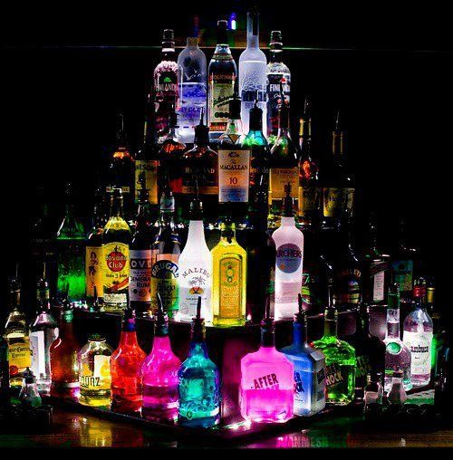
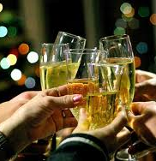
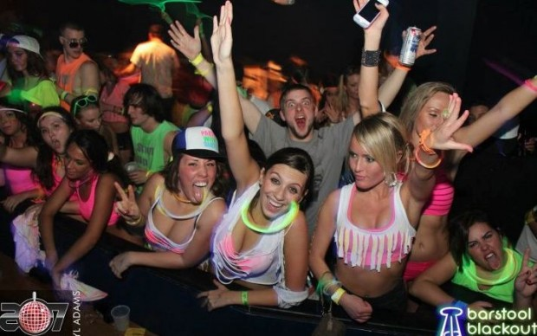
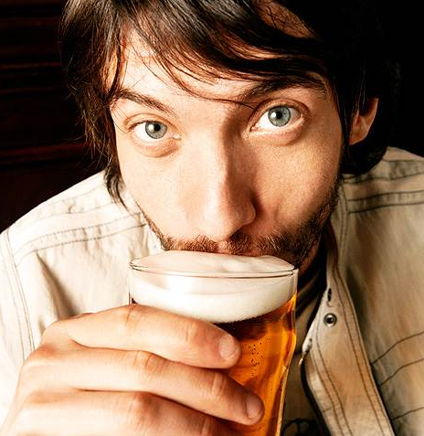
Enjoyment

Slide 13

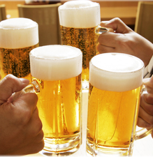
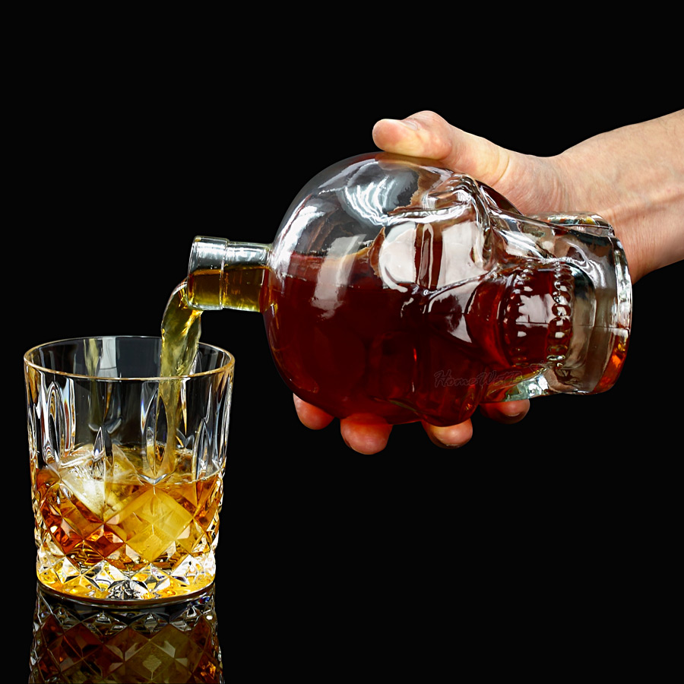
Wine
beer
or
liquor

Slide 14
Finding :Enjoyment
Why did you start consuming alcohol?

Slide 15
Finding :Enjoyment
Who do prefer to drink with?

Slide 16
Finding :Enjoyment
Where do you like to drink?

Slide 17
Finding :Effect
becoming violence because of drinking

Slide 18
Finding :Effect
giving up alcohol completely

Slide 19
Finding :Effect
drinking can influence people positively or negatively

Slide 20
Conclusion
Number of drinker and nondrinker
 | Total | drinker | Nondrinker
Number of participants | 119 | 97 | 22
How many days they consume alcohol

Slide 21
Conclusion
Connection between Financial and Enjoyment.

Slide 22
Conclusion
Connection between Financial and Enjoyment.

Slide 23
Conclusion
Limitation of study
 | Total | Nondrinker | For religious
Number of participants | 119 | 16 | 13
- Some participants do not drink.
- Main reason : religion

Slide 24
Thank you

